Slide 1
Representation Review
By Governance Team SWDC February 2024

Slide 2
Agenda
Purpose and recommended approach for the Representation Review
Timeline
Data that we need to consider
What’s next
Guidance on process and timeline
Guidance on number and nature of options from Council
Guidance on checkpoints and information required

Slide 3
Opinions and Pre-determination from Office of the Auditor-General
Is there anything you have previously done or said that might make people think you are not going to listen fairly to all the relevant information before you make your decision?
It is accepted that people working for public entities will have their own views on many matters, and, in many cases, might already have views on what the “right answer” to an issue is.
You are not required to approach every decision as though you have given it no prior thought or have no existing knowledge or opinion. However, you are required to keep an open mind, and you must be prepared to change or adjust your views if the evidence or arguments warrant it.
That means you need to take care that what you do or say does not make it look like you have already made your decision before you have considered all the relevant information and evidence.
Pre-determination — Office of the Auditor-General New Zealand (oag.parliament.nz)

Slide 4
Purpose and Process for the Representation Review
Local Electoral Act 2001: Part 1A Representation arrangements for elections of territorial authorities, regional councils, local boards, and community boards
19AMembership of territorial authorities:
Every governing body of a territorial authority is to consist of not fewer than 6 members nor more than 30 members, including the mayor, who are the members of the territorial authority.
Local Electoral Act 2001 No 35 (as at 23 December 2023), Public Act Contents – New Zealand Legislation
Statutory principles of fair and effective representation for all individuals and communities of interest of the district and not limited to reflecting majority community views on particular aspects of arrangement.
From: Local Government Commission: Representation Review Guidelines 2023 - September 2023 (lgc.govt.nz)

Slide 5
The Representation Reviews are:
Reviews of the representation arrangements for a local authority (Local Electoral Act 2001)
The Representation Review determines arrangements for:
The number of electoral areas (if any), and their boundaries, names and number of members.
The basis of elections (at large, wards or a mix of both), and
The establishment (or alteration) of community boards.
The Representation Review will include two consultations through the Special Consultative Procedure, with final decision sitting with the Commissioner.

Slide 6
Questions we need to ask:
Were there any matters arrising from the previous representation review?
Does the present number of Councillors provide effective respresentation for communities of interest?
Has there been significant changes in population in some areas which impact fair representation.
Is the current ward system appropriate for our local authority?
Are the current Community Boards appropriate? If not, is there a need for the establishment of new boards, or the de-establihsment or merger of current boards?
From: Local Government Commission: Representation Review Guidelines 2023 - September 2023 (lgc.govt.nz)

Slide 7
Four recommended stages for this work:
From: Local Government Commission: Representation Review Guidelines 2023 - September 2023 (lgc.govt.nz)
Step one is done: Consider matters related to electoral systems & Māori representation
Outcome is:
* FPP electoral systems for the 2025 and 2028 elections
* one Māori ward “at large” for the 2025 and 2028 elections
Step two: Preliminary Consultation
Community surveys
Discussion documents
Newspaper advertising
Focus groups
Public workshops
Email interested citizens
Step three: Identify Communities of Interest

Slide 8
Step 4: Determine effective Representation for Communities of Interest
The accessibility, size and configuration of the district
The existence of community boards
Number of members in each ward, mix of single and multi-member wards?
The wider statutory role of lcoal authories encompassing overall community well-being, sustainability and the interest of future generations.
The diversity of the population and the geographical locations of particular communities of interest.
Number, boundaries and names of each ward.
Step 5: Consider fairness of presentation for electors of constituencies and wards.
Identify portion of population per member for each proposed ward/constituency
Compare the ward/constituency ratios calculated with the average population per member for the local authority
Do ward/constituency ratios fall within +/- 10% of the average population per member?

Slide 9
Nameless District Council
Initial proposal for representation arrangements for the 2025 local elections
On 26 April 2024 the Nameless District Council reviewed its representation
arrangements, and resolved that the following proposal apply for the Council and its
community boards for the elections to be held on 11 October 2025:
Council Representation
It is proposed that the Council comprise 6 members elected from two wards, and the mayor. The two wards reflect the following identified communities of interest:
Ward | Communities of interest
Brown ward | Brief geographical description of Brown ward
Green ward | Brief geographical description of Green ward

Slide 10
Nameless District Council
The population that each member will represent is as follows:
Ward | Population (2018 Census) | Member | Population per member
Brown ward | 3200 | 2 | 1600
Green ward | 5800 | 4 | 1450
TOTAL | 9000 | 6 | 1500
The population each member of Nameless District Council represents falls within the range of 1500 +/-10% (1350-1650)

Slide 11
Date | Task | Responsible
February
28 | Representation Review Workshop: Past lessons & any current feedback Project Plan & Timeline review Any addition comments or issues to explore | Governance
 | Engagement with Community Begins: Step 2: Preliminary Consultation Community surveys Discussion documents Newspaper advertising Focus groups Public workshops Email interested citizens
March
13 | Strategic Working Committee: | Governance
 | Step 3: Identify Communities of Interest
 | Preliminary Consultation continues
April
 | AP+ Consultation begins
 | Step 4: Determine effective Representation for Communities of Interest
10 | Strategic Working Committee: Feedback from Preliminary consultation?
17 | Council Meeting | Governance
 | Workshop:
May

Slide 12
May
8 | Featherston Community Board meeting: Rep Review paper | Governance
22 | Greytown Community Board meeting: Rep Review paper | Governance
23 | Martinborough Community Board meeting: Rep Review paper | Governance
 | Workshop | Governance
June
12 | Council Meeting: 4-6 options presented and voted on | Governance
26 | Last date for public notification and Consultation Opens
July
10 | Council Meeting | Governance
31 | Legislative last date for Council to vote on Representation Options | Governance
26 | Consultation closes for Rep Review | Governance

Slide 13
August
7 | Council Meeting
8 | Legislative final date for public notice of an initial Proposal required | Governance/Comms
 | Step 5: Consider fairness of presentation for electors of constituencies and wards.
 | Deliberations and hearing needed
September
11 | Council Meeting: confirm final option, confirm final consultation. Reason for any amended needed. Reasons for any rejection of submissions Must be recorded in final resolution | Governance
25 | Last date for public notification and Consultation Opens | Project Team
October
2 | Final Public notice of final option and consultation begins (?14 days after) | Governance
25 | Consultation closes & sent to Commission
November
3 | Legislative date for final Consultation. Check 4 weeks or 8 weeks
December
3 | Last date for appeals/objections | Governance
20 | Last date for forwarding any appeals and objects to the Commission | Governance
April 2025
10 | Last date for the Commission to make determinations

Slide 14
Population Data
Ward | Estimated Resident Population | Members | Population Per Member
Featherston | 3,180 | 3 | 1,060
Greytown | 3,460 | 3 | 1,153
Martinborough | 3,600 | 3 | 1,200
Totals | 10,240 | 9
At the last Rep Review the following population was given.
Table 1: Estimated Resident Population at 30 June 2017

Slide 15
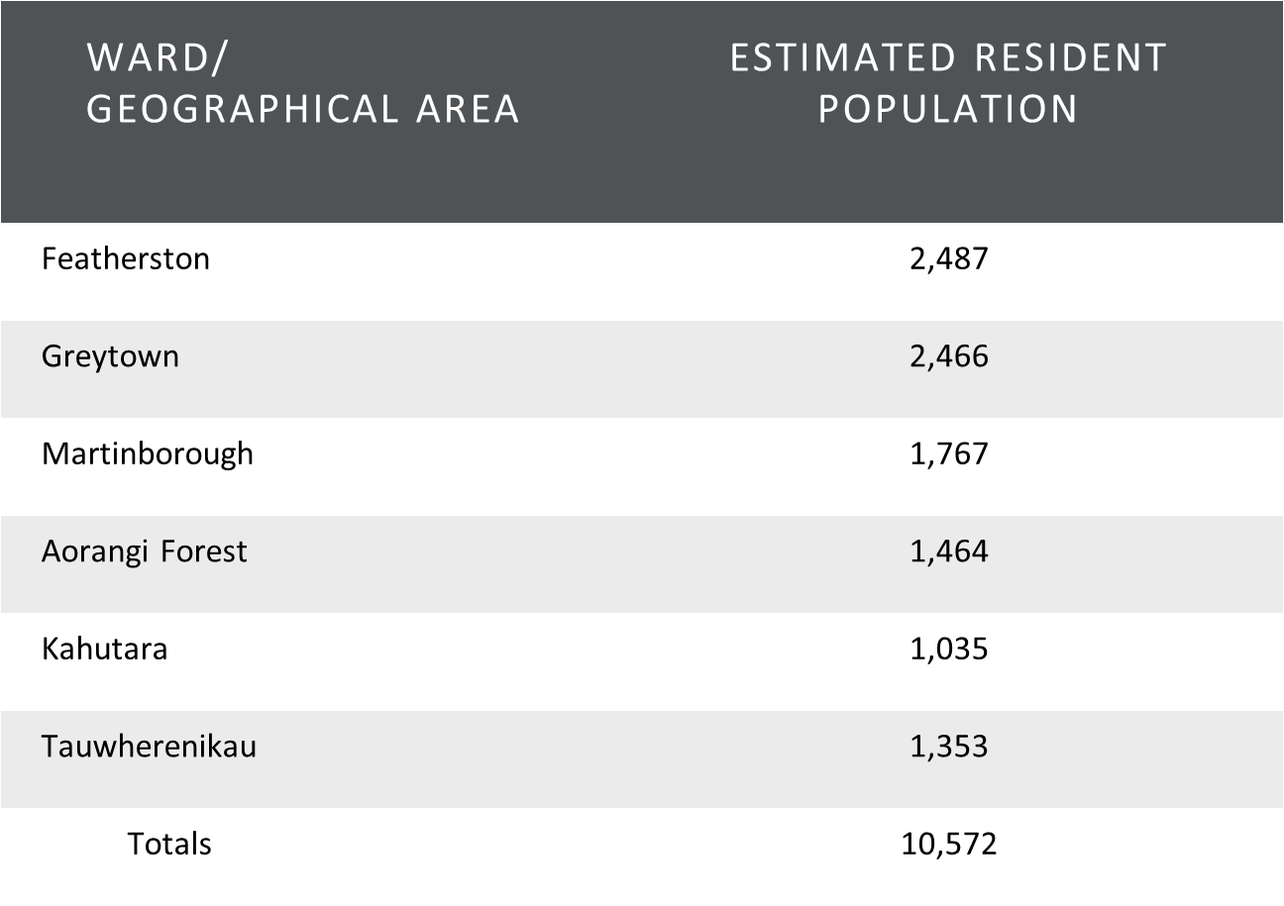
2018 Census Data has the following information: Place Summaries | South Wairarapa District | Stats NZ

Slide 16
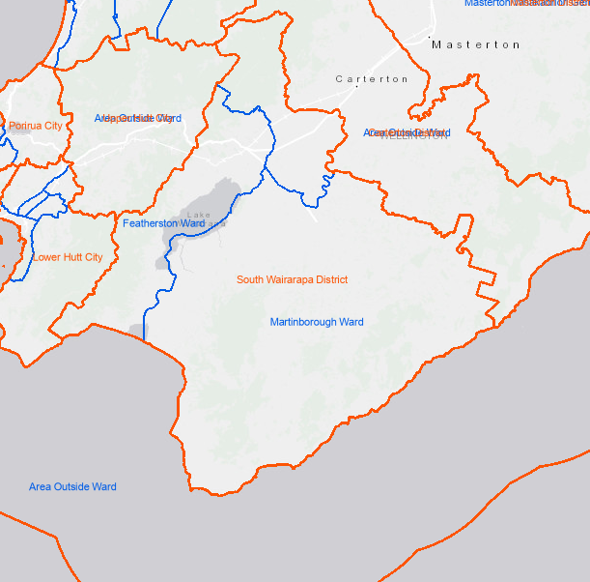
Ward boundaries
Information on the graphical ward boundaries here: - Geographic Boundary Viewer (arcgis.com)

Slide 17
What is next?
Guidance on process and timeline
Guidance on number and nature of options from Council
Guidance on checkpoints and information required
During representation reviews local authorities need to be mindful of the principles set out in section 14, Local Government Act 2002, including: • being aware of, and regarding the views of all of its communities • accounting for the diversity of the community • providing opportunities for Māori to contribute to decision-making processes.

