Slide 1

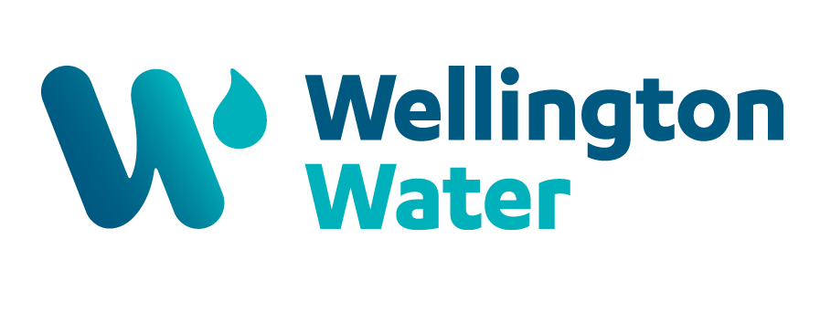
Wellington Water Half Year Report
An overview of the work Wellington Water has delivered for its council owners in the region.
1 July – 31 December 2024

Slide 2
Foreword
Welcome to this half-year report for the 2024/25 financial year.
Changes in a changing world
The path of water reform over the last few years has been dynamic and uncertain. Now, under Local Water Done Well, our shareholding councils are working at pace to develop and consult on the form and function of a new water services entity.
As our work programme has grown – for example since 2018/19, our capital programme has increased from around $65 million to more than $329 million in 2023/24 – Wellington Water has not matured. We are not right-sized for the work we must deliver for our shareholders or the region's challenges. We have not communicated our organisational needs well over the years, but we have responded to councils’ pressure to reduce costs by prioritising investment in managing assets and services over investing in the organisation's health. One reason for this has been waiting for the various water reform programmes to define and deliver the change. As a result, we are less efficient, rely heavily on consultants, suppliers and an outsourcing model to deliver core activities, and our people are not set up to do their best as they are significantly constrained by a lack of investment in systems and processes.
The corporate cost budgeting error
We faced significant scrutiny due to an error in our budget advice for the councils’ 2024/34 Long-Term Plans. This error resulted in a financial gap of approximately
$51 million. An independent review highlighted deficiencies in structure, systems and processes and made recommendations for improvement. The Board issued a public apology to councils and residents and is leading the change programme to address the recommendations and rebuild trust and confidence.
The review resulted in the development of an Organisational Capability Plan, with a range of initiatives designed to improve the capability of Wellington Water, specifically enhancing controls and assurance, improving operational effectiveness, identifying value for money opportunities, and strengthening Wellington Water’s culture and ways of working.
Pat Dougherty commenced as CEO in October 2024 and completed a high-level organisational restructure focused on an operating model that facilitates quicker decision-making and clear accountability, a recommendation from the Organisational Capability Plan. The majority of these activities require additional investment from councils to implement the recommendations from the review. Council's feedback has been that funding is not available in next year’s budgets, except for technology funding through Greater Wellington Regional Council debt funding.
Half-year Report to 31 December 2024

Slide 3
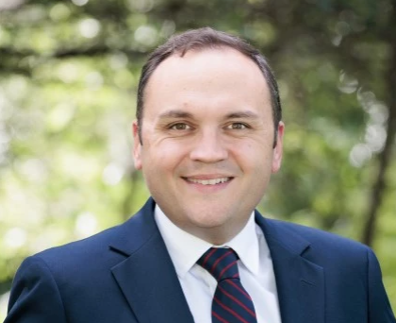
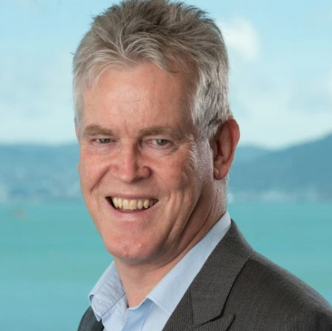
The inability to address the recommendations quickly does continue to expose Wellington Water to risks that are unlikely to be resolved until a new organisation is operating. Wellington Water will continue to drive improvement where possible through internal resources—for example, reviewing commercial arrangements with consultants and contractors.
Notwithstanding the difficulties faced this year, we continue to deliver a work programme for councils projected at just under $500 million this year. We are also focused on meeting the key expectations the Wellington Water Committee has set for us. These include demonstrating value for money, regulatory compliance, and actively contributing to developing considerations for a new water services entity.
Delivery highlights and our performance to date against our 17 SOI measures are detailed in this report.
The way forward
Our message to the Wellington Water Committee is simply this: when it comes to the changes needed to provide fit-for-pupose water services, please hurry.
As the current provider, we are committed to owning our mistakes and being unrelenting in our efforts to lift our game. So much of what we do is making a difference, but our shortcomings have undermined a lot of the good work.
After many years of waiting for change, we now recognise that we must drive change ourselves. We will work closely with the regional transition team and make the necessary changes to our operating model, procurement models, and processes on a no-regrets basis. We have requested funding for core technology systems. If approved, we will start to build the necessary basic technology systems, which will be needed for effective water services delivery. These changes will benefit any new water services entity and our residents.
Nick Leggett
Wellington Water Board Chair
Pat Dougherty
Chief Executive
Half-year Report to 31 December 2024

Slide 4
About Wellington Water
Wellington Water exists so people in the Wellington Region have safe, reliable, compliant, affordable drinking water, stormwater, and wastewater services. Our job is to provide safe and healthy drinking water, collect, and treat wastewater, and ensure the stormwater network is well managed.
Wellington Water is a council-controlled organisation owned by Wellington City Council, Hutt City Council, Porirua City Council, Upper Hutt City Council, Greater Wellington Regional Council, and South Wairarapa District Council.
Our councils own the water assets in the region and set the level of funding and investment provided. They then task Wellington Water to manage the infrastructure and deliver water services to communities based on the level of funding provided.
This Half-Yearly Report covers the period 1 July 2024 to 31 December 2024, and sets out our progress against the goals we set ourselves in Our water, our future (Wellington Water’s 2024–27 Statement of Intent).
This report will be published on our website, as well as our councils’ websites, in line with the Local Government Act.
Half-year Report to 31 December 2024

Slide 5
Strategic Focus
This year our Board of Directors have reset our strategic direction and developed a revised purpose statement along with four organisational outcomes to provide clarity and direction of our work. Our purpose sets the foundation of our work:
“Wellington Water exists so that people in the Wellington Region have safe, reliable, compliant, and affordable drinking water, stormwater, and wastewater services”
This purpose drives our commitment to achieving our four organisational outcomes:
Communities receive reliable three water services – By ensuring reliable services, we fulfill our goal of delivery of services to the community.
Services delivered by Wellington Water are compliant – Compliance with regulatory standards ensures the safety of the services we provide.
Water services are affordable and provide value – Ensuring our services are accessible and affordable.
Wellington Water is a strong and capable organisation ready to fold into a new asset-owning entity – Building an organisation that prepares us for future transitions and challenges.
To achieve these outcomes, we use the Water Committee’s strategic priorities to orient our work:
Looking after existing infrastructure; to ensure the reliability of our services
Support growth; aligns with our outcome of providing reliable services to a growing population
Ensuring sustainable water supply for the future; addresses both current and future needs, supporting our purpose of reliability and affordability
Improving water quality of our rivers, streams and harbour; this directly impacts the health and safety of our environment, te mana o te wai, community, and aligns with our compliance and reliability outcomes
Reducing our carbon emissions and adapting to the impacts of climate change; reflects our commitment to sustainability and long-term affordability
Through this alignment we can create a cohesive approach to the delivery of water services.
Half-year Report to 31 December 2024

Slide 6

Delivery Recap
399 leaks in the leaks backlog for the Wellington metropolitan region (Wellington City, Porirua, Lower Hutt, and Upper Hutt) on the public network on 6 January 2025.
Customer satisfaction has continued to lift to over 75% from a baseline of 54% set in early 2024.
An additional 20 megalitres per day of safe drinking water for the Wellington metropolitan region through upgrades at the Te Mārua Water Treatment Plant.
Continued to provide safe drinking water to the public, meeting the annual Ministry of Health target level for fluoridation.
Achieved compliance with Drinking Water standards for the South
Wairarapa Water Treatment Plants.
Exceeded Taumata Arowai’s target of a 7.4 million litres per day reduction in water use, reducing the risk of Water Restrictions Level 4 from 33% last year to under 1% this year.
Establishing clearer accountability and responsibilities suitable for an organisation our size through restructuring at the senior levels.
Delivering capital projects to the value of $129 million/year to date at a regional level and expect to deliver within our delivery range for the year of $297 million and $347 million.
Strengthened our Finance team.
Completed the Kaitoke Pipe Bridge project. Significant progress at the Whakawhirinaki - Silverstream Bridge project.
Established a Water Metering team to develop options for residential water metering. Work has begun on scoping the development of the Pākuratahi Lakes
to support long-term water supply.
Half-year Report to 31 December 2024

Slide 7
Challenges
We have faced significant compliance challenges in the wastewater treatment space, with the metro wastewater treatment plants needing improvement and further investment, particularly in addressing odour issues at the Seaview Wastewater Treatment Plant.
Significant investment is required in WWL’s technology and asset management systems to support effective and efficient operations. Until this is rectified, we will continue to be reliant on spreadsheets and end-of-life applications.
We face challenges with our current delivery models, which were appropriate for a smaller organisation delivering a smaller capital and operational programme. Now, with a larger capital programme and expanded operational workload, these models require adjustments to ensure they are delivering the value we need.
We continue to face the well-publicised challenges of managing aging assets for our councils with insufficient funding to address these issues.
Risks identified at the beginning of the year
Staff leave Wellington Water because of the uncertainty of water reform. | To date, the risk has not been realised, with turnover sitting at 11% as at Q2.
Our contractors and suppliers cannot invest in people and equipment due to uncertainty and insufficient future work | While current funding presents challenges, we are working to provide better visibility of our forward programme.
We continue to operate in a highly reactive manner, which leads to diversion of staff resources, inefficiencies and unexpected cost. | This is a live issue with work underway to improve this as part of the Organisational Capability Plan.
Our corporate system and processes are no longer fit for purpose, at the end of their technical life, and don't meet the needs and expectations of shareholding councils and customers. | This is a live issue that will continue until funding is available.
Half-year Report to 31 December 2024

Slide 8
Performance Measures
Our Statement of Intent 2024-27 outlines seventeen performance measures focusing on delivering core services.
Summary of performance measures (detailed below)
As of December 31, 2024, 53% of measures were on track, 18% of measures were at risk, and 29% were off track.
 | On track
 | At risk
 | Off track
Customer satisfaction is on the up
Customer satisfaction continues to trend positively to over 75%, up 11% on Q1 24/25 through a focus on communication, staff interaction and resolution time, reflecting improved efficiency.
# | Purpose | Measure | Target 2023/24 | Result at 31 December
1 | We deliver a level of service that our councils and customers expect. | Customers rate their experience of our performance as ‘Satisfied’ or better. | Satisfaction is >= the baseline result (54%) from January – June 2024 | 75.8% - our customer experience rating continues to lift.
Half-year Report to 31 December 2024
Notes:
Presenter: LAURENCE
Note here that this is information also appears in the pre-reading we provided attendees and copies of this diagram and more info is also printed and provided at the tables.

Slide 9
We’ve provided safe and fluoridated drinking water
Compliant drinking water
We have provided the region with safe drinking water over the last six months, significantly improving compliance at South Wairarapa District drinking water treatment plants. In the second quarter of the year, all drinking water treatment plants in the metropolitan areas met the Ministry of Health's (MoH) recommended fluoride guidelines (0.7-1.0 parts per million, 95% of the time).
As mentioned in previous reports, Waterloo Water Treatment Plant is non-compliant with chlorine rules introduced in 2022. It is currently impossible to meet the contact time requirements for chlorine at the Waterloo Plant as the first approximately 800 customers are too close to the plant. This reflects the infrastructure laid when water from Waterloo was not required to be chlorinated. However, all other customers in the Wellington Metro region receive water that is compliant with chlorine rules.
How we measure our success
# | Purpose | Measure | Target 2024/25 | Result as of 31 December
2 | The yearly average level of fluoride leaving each water treatment plant is within the Ministry of Health guidelines 95% of the time. | The yearly average level of fluoride leaving each water treatment plant is within the Ministry of Health guidelines (0.7 – 1.0 parts per million)95% of the time. | Achieved at all plants
3 | We will deliver safe drinking water to metro Wellington* | We comply with Drinking Water Quality Assurance Rules (Treatment) | Achieve full compliance at all 4 metro water treatment plants every month | Not achieved for Waterloo Water Treatment Plant (note above). The other three are compliant for reporting purposes.
4 | We will deliver safe drinking water to South Wairarapa** | We comply with Drinking Water Quality Assurance Rules (Treatment) | Compliant 12/12 months | All South Wairarapa water treatment plants are currently compliant and have been for the last 6 months
*Measured separately at each water treatment plant. The metro water treatment plants are Gear Island, Te Mārua, Wainuiomata, and Waterloo.
** South Wairarapa water treatment plants are Waiohine, Memorial Park, Martinborough and Pirinoa.
Half-year Report to 31 December 2024
Notes:
Presenter: LAURENCE
Note here that this is information also appears in the pre-reading we provided attendees and copies of this diagram and more info is also printed and provided at the tables.

Slide 10
We will improve the quality of our rivers, streams and harbours through management of wastewater
How we measure our success
# | Purpose | Measure | Target 2024/25 | Result as of 31 December
5 | Our metropolitan wastewater treatment plants (WWTP) will operate as expected. | We receive zero abatement notices, infringement notices, enforcement orders or conviction for breaches of consent | Zero notices, orders and conviction | Not achieved. We received two abatement notices and one infringement notice. A To-do Abatement Notice was issued for the Seaview WWTP, for completion of stage two of the Odour Treatment project. Work on stage two is continuing and is on programme to have a contract in place by the end of April 2025. A To-do Abatement notice was issued for Moa Point WWTP for completion of phase three of the Inlet Pump Station renewal project. This project is on track for delivery by 15 April 2025. Completion of the work will restore the inlet Pump Station capacity to its design levels. An Infringement Notice was issued for Seaview WWTP for breach of Abatement notice for missing deadline of Environmental Management Plan (EMP) for certification by the Greater Wellington regional Council. The EMP was removed early 2025. We understand the negative impact of the odour on the Seaview communities and are seeking to address the issue as soon as possible.
6 | South Wairarapa WWTP will operate as expected. | We receive zero abatement notices, enforcement orders or conviction for breaches of consent | Zero notices, orders and convictions | No notices, orders or convictions received.
Half-year Report to 31 December 2024
Notes:
Presenter: LAURENCE
Note here that this is information also appears in the pre-reading we provided attendees and copies of this diagram and more info is also printed and provided at the tables.

Slide 11
Pipe renewals
The need to renew aging pipes to reduce the impact on public and environmental health continues. Ideally, councils would renew on average 100km of the network every year for the next 30 years in order to keep it operating smoothly. Councils across the region are well below this level. Each year Wellington Water establishes a pipe renewal target based on available funding.
How we measure our success
# | Purpose | Measure | Target 2024/25 | Result as of 31 December
7 | Annual target kilometres of pipe met. | >=9.1km of pipes are renewed. | >=9.1m of pipes are renewed | Total for half year is 5.35km against an annual target of 9.1km. Forecast end of year is expected to be 10km.
Delivering the capital programme
Our capital delivery programme aims to replace and renew as many of the aging assets in our region as possible before they reach the end of their operational lives and build new assets for the future.
How we measure our success
# | Purpose | Measure | Target 2024/25 | Result as of 31 December
8 | We will deliver our capital programme within the expected range. | Total capital delivery is between $297m and $347m | $297m- $347m | The actual cost of delivery for 6 months is $129m against a budget of $148m. Expected delivery for the end of the 24/25 year is $325m.
Half-year Report to 31 December 2024
Notes:
Presenter: LAURENCE
Note here that this is information also appears in the pre-reading we provided attendees and copies of this diagram and more info is also printed and provided at the tables.

Slide 12
Looking after our people – People, health and safety
Our ability to deliver hinges on people. We seek to support people through change and support their safety. Our health and safety measure is a leading indicator of a good safety culture.
How we measure our success
# | Purpose | Measure | Target 2024/25 | Result as of 31 December
9 | Our people remain engaged with our company and its purpose. | Our overall engagement score remains stable and increases. | Overall engagement greater than 60%. | Our overall staff survey engagement score remains steady at 53%. Engagement scores are shifting, most significantly employees are committed to helping the company progress and achieve its goals (93% in Q2). The company has engaged a new CEO, a new Acting Chief Corporate Services Officer and as part of the Organisational Capability Plan has established a Chief Operating Officer role. We expect a strategic shift in performance, significant impact on culture and a lift in engagement as a result of the new senior management roles and the changes in structure and process.
10 | We will monitor and address critical health and safety risks for our people. | Health and safety risks will be reviewed, and improvement implemented. | Two or more health and safety critical risks are reviewed. | Work is on track; work will also be included in updated H&S strategy. The two H&S critical risks identified are Violence and Aggression, and Traffic Management.
Half-year Report to 31 December 2024
Notes:
Presenter: LAURENCE
Note here that this is information also appears in the pre-reading we provided attendees and copies of this diagram and more info is also printed and provided at the tables.

Slide 13
Te Mana o te Wai
Partnering with iwi and mana whenua
Water has mana, it has power, authority and influence. Water sustains life. It enables and enriches a flourishing natural environment and is an essential element to the health and wellbeing of people and communities. Embedding Te Mana o te Wai into the way we work is a multi-faceted endeavour.
We value relationships with mana whenua iwi including Taranaki Whānui ki te Upoko o te Ika, Ngāti Toa Rangatira, Ngāti Kahungunu ki Wairarapa-Tamaki Nui a Rua, and Rangitāne o Wairarapa. Two partnership agreements with Taranaki Whānui and Te Rūnanga o Toa Rangatira have been in effect since July 2023. The nature of our work means iwi input is crucial for a range of consenting, construction and operational activities we undertake.
How we measure our success
# | Purpose | Measure | Target 2024/25 | Result as of 31 December
11 | Give effect to Te Mana o te Wai. | Give effect to Te Mana o te Wai be defining what this means for Wellington Water direction on where and how it will be applied to our planning, regulatory, and operational activities. | Develop a strategy to give effect to Te Mana o te Wai. | The implementation of the Organisational Capability Plan means that we may have to delay progress on the development of the strategy, with limited ability for staff to engage meaningfully at present. In the interim, we continue to recognise and work to give effect to Te Mana o te Wai.
12 | To demonstrate our commitment to partnering with mana whenua iwi. | We regularly check with Te Rūnanga o Toa Rangatira and Taranaki Whānui that we are honouring our partnership agreements. | Annual hui confirm that we are giving effect to the purpose and values set out in the relationship agreements | We have continued engagement and hui with our mana whenua partners.
13 | To demonstrate our commitment to partnering with mana whenua iwi. | We offer partnership agreements to Ngāti Kahungunu ki Wairarapa-Tamaki Nui a Rua and Rangitāne o Wairarapa. | Partnership agreements offered to Ngāti Kahungunu ki Wairarapa-Tamaki Nui a Rua Rangitāne o Wairarapa | Exploring partnership agreements with Rangitāne o Wairarapa and Ngāti Kahungunu ki Wairarapa Tāmaki nui-a-Rua is on hold. The SWDC decided in November their preferred water services delivery model is a Wairarapa and Tararua CCO.​ We continue to engage with mana whenua iwi in the Wairarapa for our capital works projects.
Half-year Report to 31 December 2024
Notes:
Presenter: LAURENCE
Note here that this is information also appears in the pre-reading we provided attendees and copies of this diagram and more info is also printed and provided at the tables.

Slide 14
Mitigating the risks of water shortage
Ensuring a reliable and sufficient level of water supply to customers is critical. The risk of water shortages and more severe restrictions on water use has risen over the previous years. We have focused on addressing this risk over the last six months. Work is driven by three outcomes: keeping the water in the pipes; reducing water demand; and adding more water supply.
How we measure our success
# | Purpose | Measure | Target 2024/25 | Result as of 31 December
14 | There is sufficient water to meet customer needs. | Wellington Water and Councils do not implement Water Restrictions Level 4 | Achieved | This goal was achieved through a reduction in water loss and use, leading to an overall demand reduction of at least 7.4 million litres per day. This was supported by an additional 20 million litres per day of treatment capacity at the Te Mārua Water Treatment Plant.
Single integrated water meter implementation plan
The implementation of residential volumetric water meters in the region and maximising their benefit to reduce water loss and drive water conservation is a critical tool to address the region's water shortage risk in the medium to short term.
How we measure our success
# | Purpose | Measure | Target 2024/25 | Result as of 31 December
15 | We manage the region’s water shortage risk in the medium to long term. | Prepare a regionally consistent plan for roll out for residential water meters across our metropolitan council areas | A single integrated implementation plan is in place, procurement strategy is in place and detailed business case completed. | Business Case work commenced in Q2 with Strategic Case and Investment Logic Mapping workshops with Joint Advisory Group. Work continues in Q3 and Q4 with business case on track to be completed in Q4.
Half-year Report to 31 December 2024
Notes:
Presenter: LAURENCE
Note here that this is information also appears in the pre-reading we provided attendees and copies of this diagram and more info is also printed and provided at the tables.

Slide 15
Demonstrating Value for Money
The Wellington Water Committee asked Wellington Water to prove efficiency, effectiveness, transparency and oversight of work by working with shareholding councils to produce a single integrated performance framework for the region.
Review of key contracting agreements for maintenance and capital work
As requested by the Wellington Water Committee, we have reviewed contracting arrangements for maintenance and capital works to provide shareholding councils with assurance that these models deliver the best value for councils. We have made the following progress:
Reset the scope of the network and maintenance Alliance with Fulton Hogan and implemented a new performance framework for monitoring performance.
Reviewed the arrangements of the consultancy and contractor panels. We have started a work programme to improve how we get more value from our existing capex panels. These changes include the dissolution of the existing consultant and contractor panels, more open tendering, improved KPIs, and commercial analytics.
To improve our ability to actively manage the Alliance contract we have brought back key staff from the Alliance to within Wellington Water.
How we measure our success
# | Purpose | Measure | Target 2024/25 | Result as of 31 December
16 | Create a single regional performance framework | Lead work with our shareholding councils to develop a single regional performance framework | Single regional performance framework in place for reporting from 1 July 2025. | Organisation changes, including unplanned reviews and personnel changes have impacted the rate of progress. However, we plan to meet the 1 July target for simplified first draft of a single performance framework.
17 | Revisit supply chain to ensure efficiency and value for money | Review key contracting arrangements for maintenance and capital works | First review(s) completed and reported to Wellington Water Committee. Agreed actions are implemented on agreed timeframes. | Completed review and analysis on Priority 1 items which are consultancy contracting and the Alliance. Final reports on both these items are on track to be presented to the Wellington Water Committee in March 2025.
Half-year Report to 31 December 2024
Notes:
Presenter: LAURENCE
Note here that this is information also appears in the pre-reading we provided attendees and copies of this diagram and more info is also printed and provided at the tables.

Slide 16
Financial Summary
Financial Statements
INTERIM FINANCIAL STATEMENTS FOR THE PERIOD ENDED 31 DECEMBER 2024
Statement of compliance
These interim financial statements are for the six months ended 31 December 2024 and are to be read in conjunction with the annual report for the year ended 30 June 2024. They have been prepared in accordance with the requirements of the Companies Act 1993, the Local Government Act 2002 and comply with generally accepted accounting practice in New Zealand (“NZ GAAP”) and Tier 1 PBE accounting standards and comply with PBE IAS 34 Interim Financial Reporting.
These financial statements have been prepared on a going concern basis and are presented in New Zealand dollars and rounded to the nearest thousand ($000), unless otherwise stated. The measurement basis applied is historical cost.
Basis of preparation
Wellington Water Limited is a company registered in New Zealand under the Companies Act 1993 and is a Tier 1 Public Benefit Entity (PBE) for reporting purposes.
Accounting policies have been applied consistently throughout the period. All items in the financial statements are stated exclusive of Goods and Services Tax (GST), except for billed receivables and payables, which include GST. The net amount of GST recoverable from or payable to the Inland Revenue Department is included as part of receivables or payables in the statement of financial position.
The Water Services Entities Act 2022, along with the Water Services Legislation Act 2023 and the Water Services Economic Efficiency and Consumer Protection Act 2023, was repealed by the Water Services Acts Repeal Act 2024 on 15 July 2024. This repeal marks the end of the 10-entity model and returns the responsibility for water services delivery to local authorities. Under the new “Local Water Done Well” policy, legislated in August 2024, the government aims to enhance the efficiency, sustainability, and quality of water services through stronger central government oversight and economic regulation. These financial statements have been prepared on a going concern basis, reflecting the transition to the new framework.
Half-year Report to 31 December 2024

Slide 17
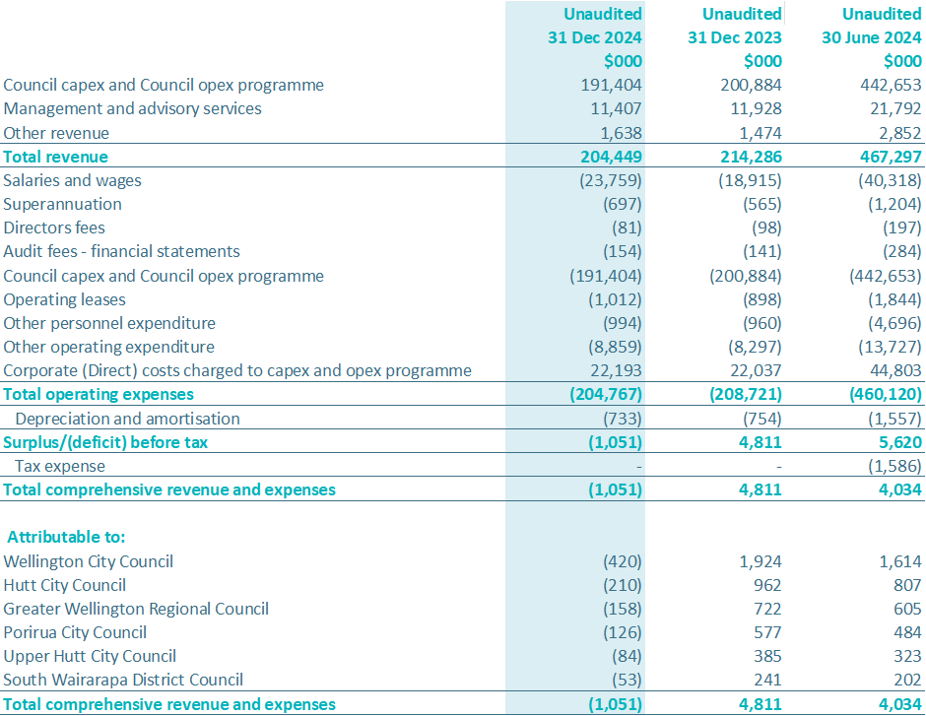
Financial Statements
STATEMENT OF COMPREHENSIVE REVENUE AND EXPENSES
For the period ended 31 December 2024
Comparison of results for the six months ended 31 December 2024 to the same period last year
Revenue: The Council Capex programme revenue decreased by $22m, while the Council Opex programme revenue increased by $12m. These variations are attributed to the specific plans and budgets outlined in each council’s Long-Term Plan. There was an overall net revenue decline of approximately $10m compared to same period last year.
Expenses: Wellington Water's expenses decreased by $4m over the same period last year, due to a reduction in the council capex programme.
Net Deficit: The net deficit for the half-year ended 31 December 2024 stands at $1m.
STATEMENT OF CHANGES IN EQUITY
For the period ended 31 December 2024
Half-year Report to 31 December 2024

Slide 18
Financial Statements
STATEMENT OF FINANCIAL POSITION
For the period ended 31 December 2024
Comparison to Statement of Financial Position on 30 June 2024
Current Assets: Current assets were lower compared to 30 June 2024, primarily due to reduced outstanding receivables. At the end of the financial year, a significant portion of council receivables was related to revenue in advance invoices. These invoices support the capex and opex programmes during July, when funding is impacted by delayed council budget approvals. This situation is unique to the end of the financial year, resulting in a higher variance.
Current Liabilities: Current liabilities were also lower compared to 30 June 2024, mainly due to higher trade payables and provisions at year-end. This increase was driven by elevated spending on council capex and opex programmes towards the end of the year, and some council revenue received in advance was classified as a current liability. This situation is specific to the end of the financial year, leading to a higher variance.
Equity: Equity at the end of the half-year, 31 December 2024, includes the $1m deficit from the statement of comprehensive revenue and expenses.
Half-year Report to 31 December 2024

Slide 19
Financial Statements
STATEMENT OF CASH FLOWS
For the period ended 31 December 2024
Half-year Report to 31 December 2024

